Slide 1
Build Your own dv automation on azure synapse
Noel Cruz
Notes:
Imagine this: You’re having a conversation with someone about whatever topic, and that person responds by saying, “I’m not gonna lie…” Has anyone here ever experienced that?
Please don’t confess whether or not you yourself use this phrase
Why? Well, when anyone uses that phrase around me, I immediately don’t trust them. Think about it. If someone has to pre-qualify their next statement as being a true statement, I begin to wonder, “Wait…have you been lying to me this WHOLE TIME?! And why in the world should I even trust the next statement out of your mouth, especially since you felt the need to tell me that you’re not going to lie?”
So, the next time a colleague approaches you and says, “I’m not gonna lie, this data is reliable,” run away as fast as you can!
What in the world does this have to do with you today? Well, everything. You see, the fact that I stand here before you today inherently implies that what I have to say is reliable. Now, I know I’m standing before data professionals who likely are skeptical by nature, and rightfully so, especially if we consider what Scott talked about in yesterday’s session. That’s great! Please do that. Please question everything I share with you today because everything we are doing today with data may or may not change tomorrow. Our “truth” is a moving target (though not all truth is that way).
By the way…a quick shiny thing: Did anyone else notice in Jennifur Stirrup’s presentation this morning that she had a slide with the scrabble letters forming the word, “Promise?” Did you notice the word score one it? Eleven points. Eleven is a prime number. It implies that a promise either is or isn’t. There is no dividing it any other way.
Anyway, because of what I learned yesterday from Mary, I have already had to change the title of my presentation from automation to [next slide]…

Slide 2
Build Your own dv ACCELERATION on azure synapse
Noel Iván Cruz
Notes:
….ACCELERATION. Thank you, Mary!
Good afternoon, fellow Data Vault professionals. I am Noel IVAN Cruz.
Ivan the Terrible…Ivan the Great…or even Ivan the Imposter (thank you Mike, for making me question my own identity. I’m not gonna lie, I AM Noel Ivan. I brought a birth certificate to prove it to you…and if any of you need the name of my forger, come find me afterward)….
You decide. You may choose Terrible after seeing what I have to share today, and that’s OK! What I share is not the only way to do this. It may be terrible. Fine. At least it has you thinking about doing something differently (I certainly am).
The Great. You may LOVE what I have to share. Okkkk…..to each his own. At least now you have a place to start.
The Imposter. For some with whom I have interacted this week, you already know I have a background in clowning and music.
In fact, I’ve been working with several other IT professionals that have a background in music. We’ve started a band called 1063 Megabytes. We don’t have a Gig yet.
You may decide I have no credibility because I don’t have the sheet of paper that says I’m a data professional. Ok, fine. No problem. I invite you to challenge me. I need it. I cannot become a better data professional without challenges along the way. I have not arrived, nor will I ever claim to arrive. There is a Biblical proverb (27:17) that says, “As iron sharpens iron, so one man sharpens another.” I invite you today to sharpen me, and I will do the same with you, to the best of my ability.
[next slide: Agenda]

Slide 3
AGENDA
Introduction: Why Build Your Own?
Gathering the Basic Automation Tools
Building the Automation Templates
Creating the Automation Structures
Developing the Automation Pipelines
Resources
Notes:
Why Build Your Own?
Gathering the Basic Automation Tools
We will simply talk about the different architectural components I’m using in this solution
As you know, there are many ways to do the same thing
Keep in mind, though that there is a Highway to Hell and only a Stairway to Heaven
Building the Automation Templates
We will discuss how the templates in DV allow you to write code that writes code
Creating the Automation Structures
We will see the database I created that supports storing the metadata we need to generate the code
Developing the Automation Pipelines
How do we orchestrate all of this?
You provide the metadata…the input…the engine handles the rest
Resources
I’ll share with you a couple of references that helped me get started down this road of building this acceleration tool

Slide 4
Introduction: why build your own?
A short story from a developer who has done it…twice!
Notes:
Great question! Why build your own when more and more acceleration tools are hitting the market now?
Well, you may or may not be in a situation where funding is not yet available for a tool. You may be in a situation where you’re attempting to prove out the Data Vault to your company, and your resources consist of a few engineers and developers to put it together. Whatever the case may be, you are in this position now and need a way to deal with it.
Let me share my story about how I learned about Data Vault….

Slide 5
Gathering the basic automation tools

Slide 6
What is azure synapse?
“Azure Synapse is an enterprise analytics service that accelerates time to insight across data warehouses and big data systems. Azure Synapse brings together the best of SQL technologies used in enterprise data warehousing, Spark technologies used for big data, Data Explorer for log and time series analytics, Pipelines for data integration and ETL/ELT, and deep integration with other Azure services such as Power BI, CosmosDB, and AzureML.”
SOURCE: https://docs.microsoft.com/en-us/azure/synapse-analytics/overview-what-is

Slide 7
Defining synapse
syn​•apse | \sə-ˈnaps\
: the point at which a nervous impulse passes from one neuron to another
Etymology: New Latin synapsis, from Greek, juncture, from synaptein to fasten together, from syn- + haptein to fasten
SOURCE: https://www.merriam-webster.com/dictionary/synapse

Slide 8
Gathering tools
While Azure offers a variety of viable options, I chose to use Azure Data Lake Storage Gen2 (ADLS Gen2). Performance, scalability and security helped make this an easy choice…that and Azure defaults to this when setting up an account.
Land the Data
Store the Data
Azure’s SQL Dedicated Pool sits at the heart of Azure Synapse. It uses columnar storage for relational data, which can be manipulated and accessed with T-SQL.
Azure Synapse provides an array of tools to transform the data according to Data Vault standards. Views, stored procedures and SQL functions (including user defined) form the bulk of this automation.
Conform the Data
Move the Data
Pipelines and Triggers together form the engine that moves the data from source to target.

Slide 9
building the automation templates

Slide 10
Generating hubs
Pseudo-Code
Stored Procedure Template
SELECT
HashKey,
BusinessKey,
LoadDateTimeStamp,
RecordSource
FROM Stage STG
WHERE STG.HashKey NOT IN (
SELECT h.HashKey
FROM Hub h
WHERE STG.HashKey = h.HashKey
)
CREATE PROCEDURE stage2.sp_BuildHub
@TgtHub VARCHAR(255)
AS
BEGIN
DECLARE @sql VARCHAR(MAX)
WITH meta AS (
SELECT <metadata>
FROM DVEngine
WHERE FQTableName = @TgtHub
)
SELECT @sql = ‘<build based on pseudo-code>’
FROM meta
EXEC (@sql)
END

Slide 11
Generating links
Pseudo-Code
Stored Procedure Template
SELECT
LinkHashKey,
HubKey1,
HubKey..n,
LoadDateTimeStamp,
RecordSource
FROM Stage STG
WHERE STG.LinkHashKey NOT IN (
SELECT l.LinkHashKey
FROM Link l
WHERE STG.LinkHashKey = l.LinkHashKey
)
CREATE PROCEDURE stage2.sp_BuildLink
@TgtLink VARCHAR(255)
AS
BEGIN
DECLARE @sql VARCHAR(MAX)
WITH meta AS (
SELECT <metadata>
FROM DVEngine
WHERE FQTableName = @TgtLink
)
SELECT @sql = ‘<build based on pseudo-code>’
FROM meta
EXEC (@sql)
END

Slide 12
Generating satellites
Pseudo-Code
Stored Procedure Template
SELECT DISTINCT
STG.HashKey,
STG.<satellite attribute columns>,
STG.LoadDateTimeStamp,
STG.RecordSource,
STG.HashDiff
FROM Stage STG
LEFT OUTER JOIN SAT ON
(STG.HashKey = SAT.HashKey
AND SAT.LoadDateTimeStamp = (SELECT
MAX(latest.LoadDateTimeStamp)
FROM SAT latest
WHERE latest.HashKey = SAT.HashKey)
AND SAT.HashDiff != STG.HashDiff
CREATE PROCEDURE stage2.sp_BuildSat
@TgtSat VARCHAR(255)
AS
BEGIN
DECLARE @sql VARCHAR(MAX)
WITH meta AS (
SELECT <metadata>
FROM DVEngine
WHERE FQTableName = @TgtSat
)
SELECT @sql = ‘<build based on pseudo-code>’
FROM meta
EXEC (@sql)
END
Notes:
We will discuss Creating the Automation Structures next, and from there, we will take a quick look at some of the code (because going through all of it would be tedious and painful)

Slide 13
Creating the automation structures

Slide 14
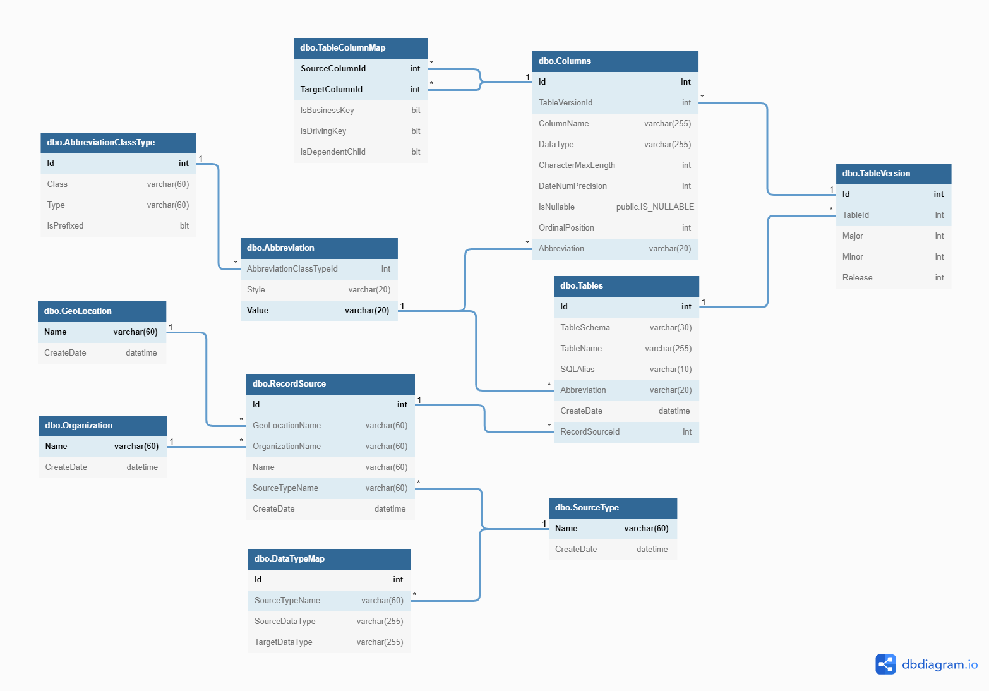
Azure DV Engine data model
Metadata Layout - dbdiagram.io

Slide 15
developing the automation pipelines

Slide 16
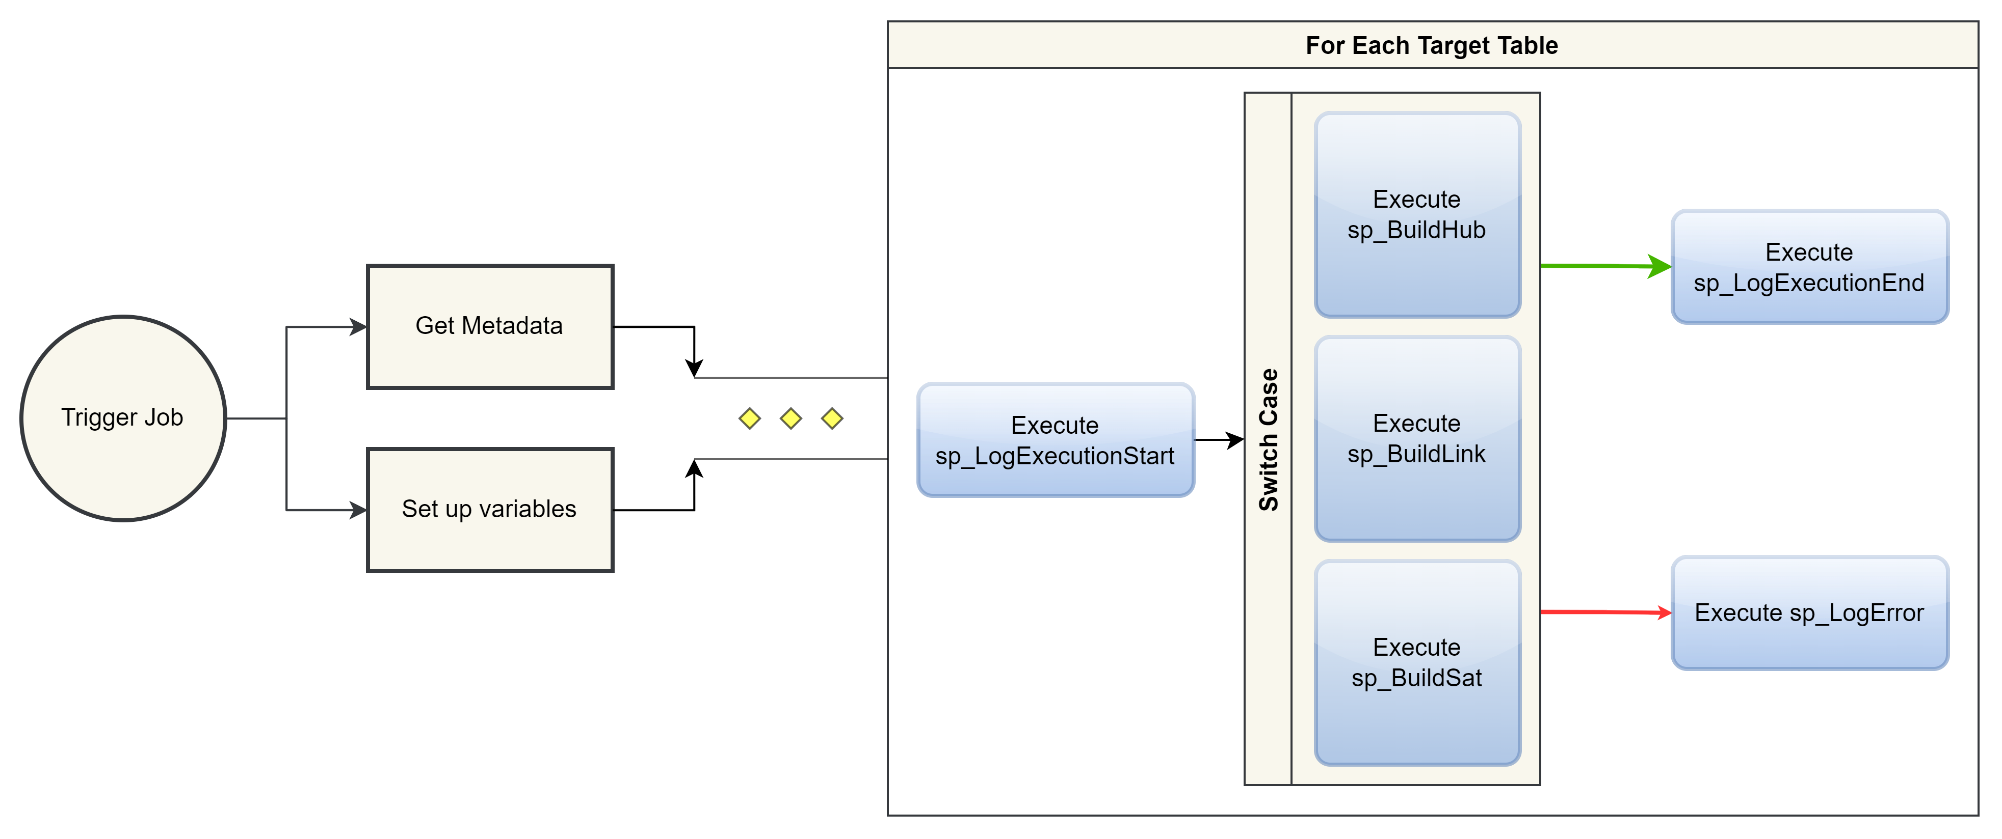
The basic pipeline flow for now
Notes:
Look at the code and the pipelines

Slide 17
Resources
Deploying Data Vault on Azure SQL Data Warehouse (microsoft.com) [https://azure.microsoft.com/en-us/resources/deploying-data-vault/]
(92) Design your Data Vault and Load it with Azure Data Factory - Rayis Imayev – YouTube
My GitHub Repo for this Presentation and Project

Slide 18
THANK YOU
Noel Cruz
noel.ivan.cruz@gmail.com
www.github.com/nicruzer

